Slide 1



RETIREE Benefits
City of Fort Lauderdale

Slide 2






Meet The team
Mikki Sampo​
Shane Meehan
Yslande Agenor​​
Benefits Manager
Benefits Specialist
A - L
Benefits Analyst​
M - Z
101 NE 3rd Avenue
Human Resources – 16th Floor
Fort Lauderdale, FL 33301
PH: 954-828-5160
Website: www.fortlauderdale.gov/benefits
Email: Healthyliving@fortlauderdale.gov
FAX: 954-828-5328
Melissa Ferrer
Mia Daniels​
Senior Accounting Clerk​
Benefits Assistant

Slide 3

What Benefits are available to YOU?
City Core Benefits (IAFF)
Medical – Dental – Vision
Health Benefit Stipend
Voluntary Benefits

Slide 4



Plans
core
ELIGIBILITY
Employees covered under the City’s Benefit Plan(s) at time of retirement may participate in the City’s retiree program.​

Slide 5
mEDICAL insurance (iaff)
 | Open Access Plus In-Network 1 (OAPIN1/HMO1) | Open Access Plus In-Network 2 (OAPIN2/HMO2)
Deductible – what you pay before the plan pays | No Deductible | $1,000 = EE $2,000 = EE+1 $3,000 = EE+2 or more
Co-Insurance | n/a | You pay 20%
Out-of-pocket maximum | $5,000 = EE $7,000 = EE+1 $10,000 = EE+2 or more | $6,350 = EE $10,000 = EE+1 $12,700 = EE+2 or more
Lifetime Maximum | Unlimited | Unlimited
Preventive Services | No Charge | No Charge
Primary Care Physician | $35 | $35
Specialist Physician | $35 | $35
Hospital | $250/day, $2,500 Maximum | Deductible then 20%

Slide 6
mEDICAL insurance (IAFF)
Choice Fund (CDHP) with a Health Reimbursement Arrangement (HRA)
Health Reimbursement Account (HRA)
 | In-Network | Out-of-Network**
Deductible – what you pay before the plan pays | $2,000 = EE $3,000 = EE+1 $4,000 = EE+2 or more | $2,000 = EE $3,000 = EE+1 $4,000 = EE+2 or more
Co-Insurance | You pay 10% | You pay 30%
Out-of-pocket maximum | $5,000 = EE $7,000 = EE+1 $10,000 = EE+2 or more | $5,000 = EE $7,000 = EE+1 $10,000 = EE+2 or more
Lifetime Maximum | Unlimited
Preventive Services | No Charge | Not Covered
$1,200 = EE
$1,800 = EE+1
$2,400 = EE+2 or more

Slide 7
Medical insurance rates (IAFF)
Medical​ | HMO 1​ (OAPIN1)​ | HMO 2​ (OAPIN2)​ | CDHP​ (w/ HRA 2025)​
Retiree Only​ | $1,008.30 | $917.75 | $885.37
Retiree + Spouse​/DP | $2,068.56 | $1,916.40​ | $1,816.60
Retiree + Child​ | $1,362.14 | $1,290.88 | $1,181.42
Retiree + Children​ | $1,866.90​ | $1,754.59​ | $1,635.47
Family​ | $2,876.41​ | $2,648.18​ | $2,543.55​
Adult Child (Age 26 – 30) | + $353.84/ Adult Child | $373.13/ Adult Child | $277.07/ Adult Child

Slide 8
Medical insurance rates (IAFF)
Over 65
Medical​ | HMO 1​ (OAPIN1)​ | HMO 2​ (OAPIN2)​ | CDHP​ (w/ HRA 2025)​
Retiree Only​ | $907.47 | $825.98 | $796.83
Retiree + Spouse​/DP | $1,861.70 | $1,724.76 | $1,634.94
Retiree + Child​ | $1,253.93 | $1,161.79 | $1,063.28
Retiree + Children​ | $1,680.21 | $1,579.13 | $1,471.92
Family​ | $2,588.77 | $2,383.36​ | $2,289.20
Adult Child (Age 26 – 30) | + $353.84/ Adult Child | $373.13/ Adult Child | $277.07/ Adult Child

Slide 9
DENTAL insurance (IAFF)
PLAN FEATURES | Annual Participant Maximum | Preventive Services Exam Cleaning Fluoride X-rays Sealants | Basic Services Fillings Periodontics Endodontics | Major Services Crowns Bridges Dentures | Orthodontia
PPO In-network or out-of-network benefits | $1,500 per participant $100 Deductible | Covered at 100% 2 oral exam and 2 cleanings per year | Covered at 80% subject to Deductible | Covered at 50% subject to Deductible | Lifetime Max: $1,500 Covered at 50%

Slide 10

DENTAL insurance rates (IAFF)
Dental​ | IAFF PPO​
Retiree Only​ | $33.36
Retiree + Spouse/DP | $60.98
Retiree + Child(ren)​ | $54.07
Family​ | $95.54

Slide 11


vision insurance CORE PLAN (iaff)
In-Network Benefit | Frequency | Cost
Eye Exam | 1x every year | $10 copay
Lenses | 1x every year | $25 copay
Frames | 1x every other year | $130 retail allowance
Contacts (in lieu of glasses) | Up to 4 boxes every year | $25 copay

Slide 12
vision insurance Buy-UP (iaff)
In-Network Benefit | Frequency | Cost
Eye Exam | 1x every year | $0 copay
Lenses | 1x every year | $25 copay
Frames | 1x every other year | $260 retail allowance
Contacts (in lieu of glasses) | Up to 8 boxes every year | $0 copay

Slide 13

Vision insurance rates (IAFF)
Vision​ | Core Plan | Buy-Up Plan
Retiree Only​ | $4.58 | $7.89
Retiree + Spouse/DP | $9.15 | $15.78
Retiree + Child(ren)​ | $9.79 | $16.89
Family​ | $15.65 | $26.99

Slide 14

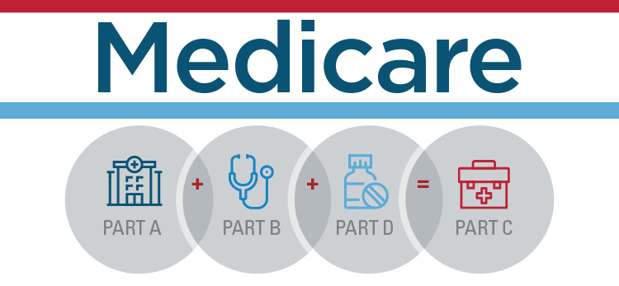
Alternatives
COBRA
18 to 36 months Continuity in Coverage
60 Days to Enroll
Administered by TASC
Health Insurance Marketplace
https://www.healthcare.gov/
Affordable Health Plans
Open Enrollment November 1st – January 15th
Medicare 65+
https://www.medicare.gov/
Must Enroll at age 65
Open enrollment period October 15th - December 7th.

Slide 15

Health Benefit stipend (iaff & fop)
$400 per month @ Normal Retirement
    Hired prior to 4/1/2014 (FOP)
    Hired prior to 6/16/2015 (IAFF)
Starts first of the month following last day
Ends at age 65 or Medicare Eligibility

Slide 16






Portability Privilege
Coverage may continue at RETIREMENT
Grace Period
  31 days Supplemental Insurance
  60 days Term Life
  Written Notice/Calling
Change of Rate
Pay Premium Directly to Vendor
Life Insurance
Critical Life
Accident
Hospital
​Legal

Slide 17




457 (b) Voluntary Deferred Compensation
Set Appointment w/ Retirement Specialist
Update
Beneficiary
Contact
Payroll

Slide 18

Y☺ur Benefits c☺ntacts
Shane Meehan – Benefits Specialist
Last Name A-L
954-828-5116
smeehan@fortlauderdale.gov
Yslande Agenor – Benefits Analyst
Last Name M-Z
954-828-5188
yagenor@fortlauderdale.gov

Slide 19


Thank You!

