Slide 1


APPROACHING AND LIVING IN RETIREMENT
DEAR future self
Ten things to think about when planning for and living in retirement
Notes:
Welcome! Today we will discuss key considerations as you approach retirement: DROP, Investment Plan, Final Accrual Payout, Catch up, Distributions options, Stay in plan after retirement, and much more!
I am Ana Aguirre and I’m a [TITLE]. We’ll have some time at the end of our session today for Q&A, but feel free to ask questions as we go along as well.
I am excited to share all this information with you, as well as Nationwide's many tools and resources because the objective is that you can have an overall knowledge to help you understand your options and help you put the pieces of the puzzle together as your planning for the longest weekend of your life a/k/a your retirement.
We know each one of you are individuals with a unique vision for your retirement. We would also like you to keep in mind, that although you are retiring from your employer, you are not retiring from Nationwide or us. We started the journey with you while you are working and will continue to be there for you through out your retirement years.
Therefore, I encourage you to talk with your one of your nine local reps so we can help set a plan of action tailored to your individual retirement needs.

Slide 2


TEN RETIREMENT to-dos
2
Notes:
At NW we know that retirement is as unique as each individual planning for it. That’s why at Nationwide, we define retirement as your vision for the future — not as dollars and benchmarks.
Your best life is possible when you have the right plan in place.
Let’s look at how your vision comes to life as you approach — and continue to live in — retirement.
There are many factors to consider in this stage of life.
Let’s look at 10 of the biggest pieces to the retirement puzzle.

Slide 3

TEN RETIREMENT TO-DOs
1. Plan for a long life
6 in 10 BABY BOOMERS
fear running out of money over death itself.
¹
¹https://www.allianzlife.com/about/news-and-events/news-releases/ Generations-Ahead-Study-2017
3
Notes:
My Dad is 87 years old. He worked for his company for 30 years. He was lucky that he had a defined benefit Pension program, which is rare for the private sector now, He retired at the age of 56, that means he has been retired for 31 years & hopefully longer! In fact, on his 86th birthday my brothers and I teased him saying that he was at the break even point, 30 years working for the company & 30 years retired! He always used to say jokingly, I’ll be lucky if I live for 20 years in retirement.
My point is…..
Thanks to modern medicine & healthier lifestyle choices,
People are living longer than ever before.* That means you will likely spend more years in retirement than the generations before you did. Don’t run the risk of outliving your income.
¹https://www.allianzlife.com/about/news-and-events/news-releases/ Generations-Ahead-Study-2017
*https://ourworldindata.org/life-expectancy

Slide 4
TEN RETIREMENT TO-DOs
2. Will you have enough money to last
through retirement?
The three major costs in retirement:
Inflation
Health & LTC
Longevity
¹
4
Notes:
Things likely will cost more in just a few years. The Dept. of Labor calculates that what cost $10,000 in 1995 likely costs more than $15,637.53 today.¹ Think about what that could mean to your money 20 years from now.
The most relevant health care costs to retirees are those they must pay themselves. If you are retiring before the age of 65- an important factor that must be considered is paying for health insurance- then once at age 65 you qualify for Medicare- but even then you must factor in for
supplemental insurance & prescriptions for medicine. ( plug Tim Omara- NW Retirement Inst)
A 65-year-old couple retiring today can expect to spend about $220,000 over the next 20 years on out-of-pocket health care expenses.²
According to the National Clearinghouse for Long-Term Care Information, at least 70% of people over the age of 65 will require some form of long-term care in their lifetime. Based on a national average of $6,235 per month for a semi-private room, the cost of long-term care can be expensive. ³
What are we getting for our health care money? We’re living longer.
The Census Bureau projects that the population age 85 and over could grow from 5.5 million in 2010 to 19 million by 2050. Living past 100 is becoming more and more probable.⁴ BTW- my grandfather, my dad’s dad lived to 104!
Although it seems odd to say, living longer is a real risk. Especially to your money.

Slide 5
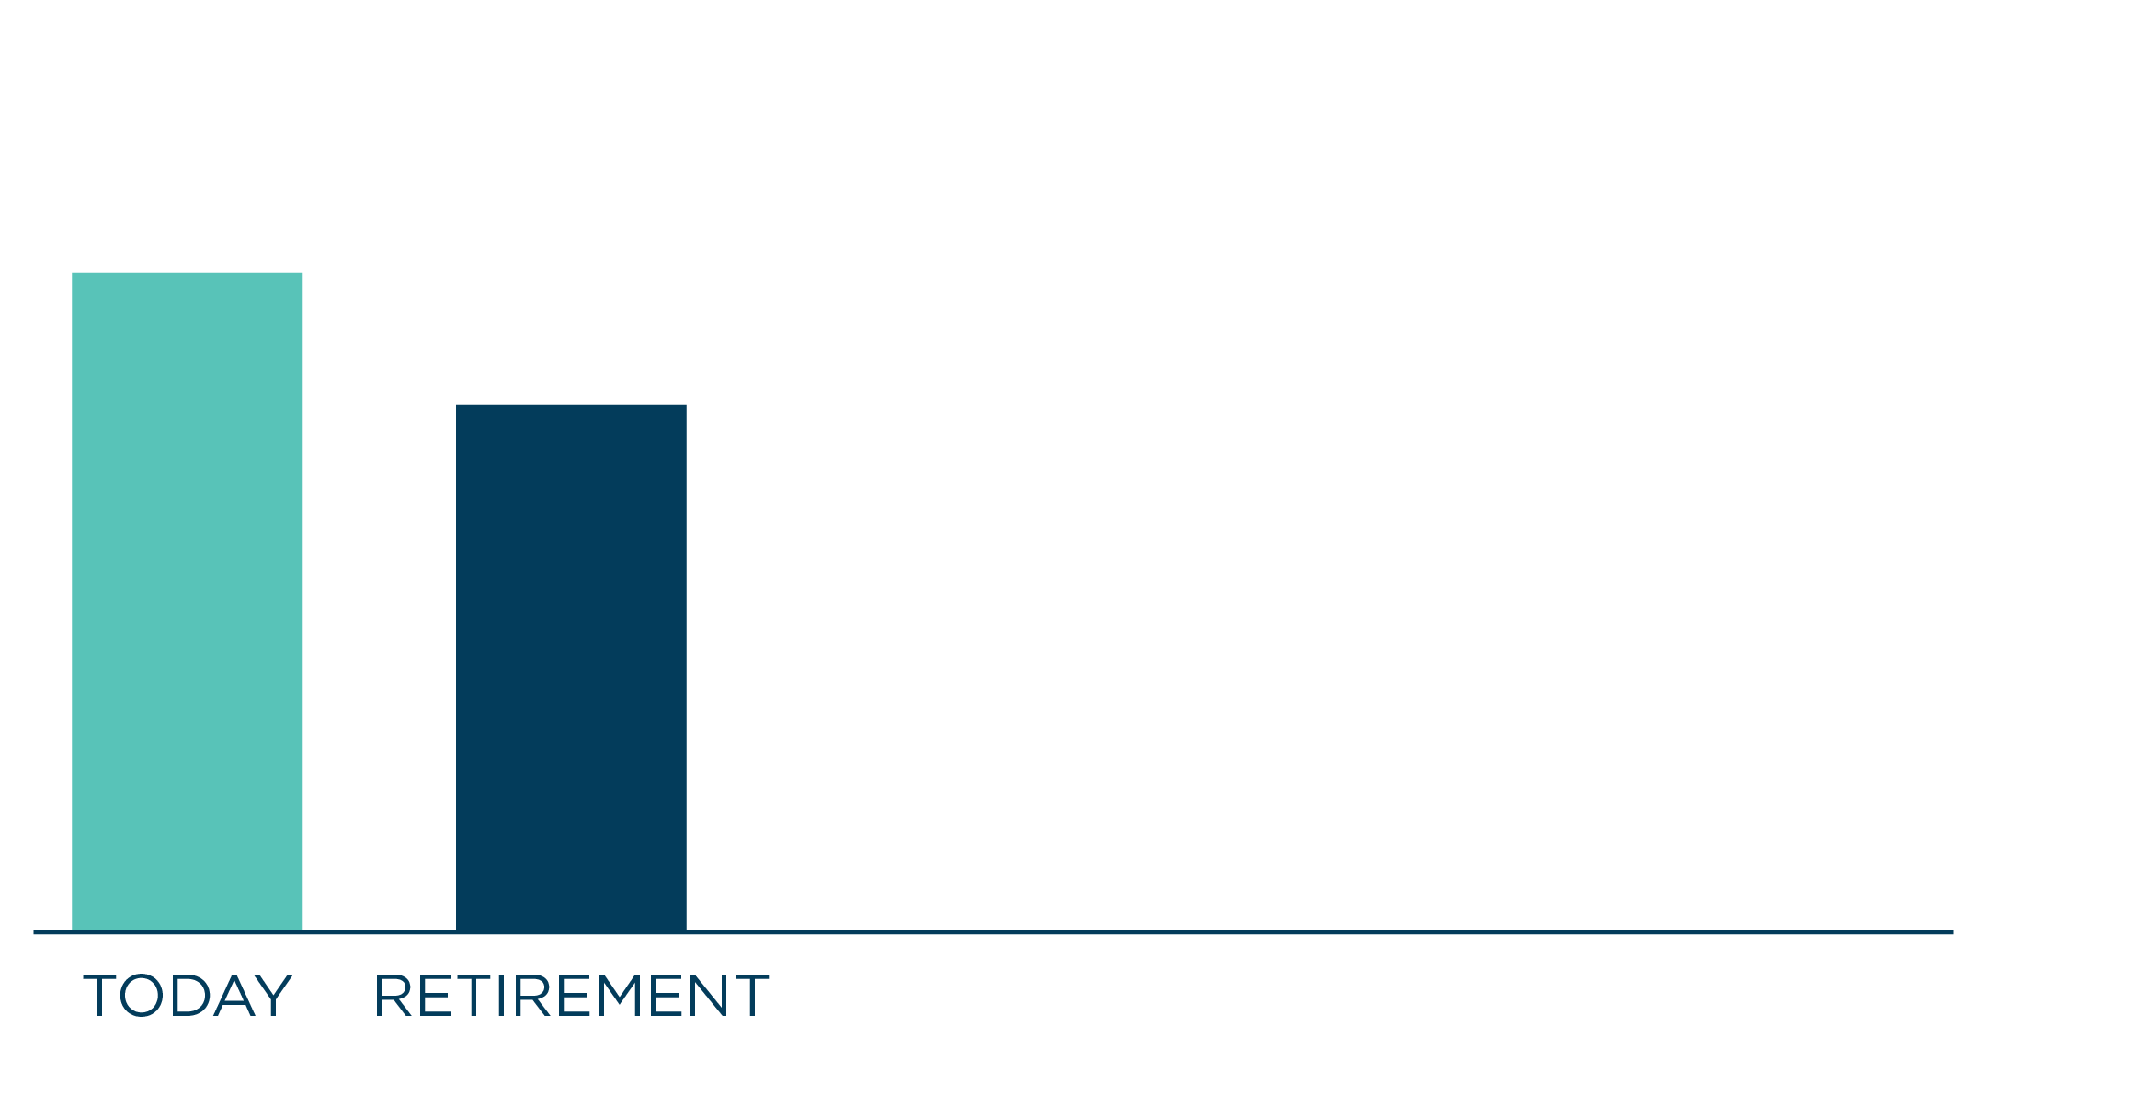
TEN RETIREMENT TO-DOs
3. Determine the lifestyle you want to live.
Research shows that you may need up to 80% of what you earn now to maintain the same lifestyle in retirement²
²https://www.fool.com/retirement/2017/08/05/heres-how-much-income-youll-need-after-you-retire.aspx
5
Notes:
So then, you might be asking yourself, exactly how much money will I need at retirement? Well, most financial experts say that you will need up to 80% to maintain the same standard of living.
Whenever, I have assisted anyone planning for retirement, I aim to get them at 100% or even a bit more….
Consider all your expenses:
• Consider your mortgages, utilities, car payments and other monthly expenses
• Plan for your leisure activities along with your fixed expenses, such as traveling- until around the age of 75, my dad was able to travel at least 1 or 2 times per year.
What fixed expenses will carry over into retirement?
² https://www.fool.com/retirement/2017/08/05/heres-how-much-income-youll-need-after-you-retire.aspx

Slide 6
TEN RETIREMENT TO-DOs
4. Know the main sources of your retirement income
Fort Lauderdale Police/Fire Pension
Personal savings
Employer 457(b) Deferred Compensation: www.FTL457.com
Social Security: www.SSA.gov
DROP - Deferred Retirement Option Plan
Accrual of Sick & Vacation Pay
6
Notes:
PENSIONS: FRS will account for about 50% of your retirement income.
PERSONAL SAVINGS: Consider how much you’ll need to have in savings in order to live the retirement you imagine
EMPLOYER RETIREMENT PLAN: These plans, such as your 457(b), are quickly becoming the largest form of retirement income
SOCIAL SECURITY: According to the Social Security Administration, Social Security benefits typically account for (at most) 40% of what you earn now*
* http://www.pensionrights.org/publications/statistic/how-many-american-workers-participate-workplace-retirement-plans
* Better Information on Income Replacement Rates Needed to Help Workers Plan for Retirement, Government Accountability Office (March 2016); Understanding The Benefits, Social Security Administration (July 2017). Calculated as amount of pre-retirement income GAO says an average person needs in retirement less the amount of income SSA says Social Security replaces, on average.

Slide 7
2
Take advantage of catch-up opportunities (ages 50+)
2026 IRS catch-up contribution limits¹
Plan Type | Maximum Elective Deferrals | Age 50+ Catch-Up | Age 60-63 Catch-Up | 457(b) Special Catch-Up
457(b)/Roth 457(b) combined limit | $24,500¹ | $32,500^{1,2} | $35,750^{1,2} | $49,000
Beginning January 1, 2026, the SECURE 2.0 Act’s Section 603 requires participants earning more than $150,000 in the prior year’s FICA wages* to make age-based catch-up contributions on a Roth (after-tax) basis. The 603 provision does not apply to 457 special catch up. That full amount can be contributed on a pre-tax basis regardless of FICA wages.
*FICA wages are the types of pay that count toward Social Security taxes. This includes salary, tips, bonuses, commissions and some extra benefits an employee might receive (like a company car or gym membership). You can find this total in Box 3 of a W-2 form.
¹ Limits subject to change year to year
² If plan allows.
³ Deferral maximum is for employer and employee contributions combined.
This table assumes includable compensation exceeds contribution limits.
Source: irs.gov/newsroom/401k-limit-increases-to-24500-for-2026-ira-limit-increases-to-7500
Investing involves market risk, including possible loss of principal. Actual results will vary, depending on your investment and market experience. Retirement Specialists cannot offer investment, tax or legal advice. You should consult your own counsel before making retirement plan decisions.
Notes:
Second, if you’re age 50 or older, you can take advantage of catch-up contributions. As the name implies, it’s an amount the IRS allows you to contribute over the normal limit that allows you to catch up. You just can’t contribute more than you earned. Keep in mind that not all plans allows this, so you’ll need to see if yours does.
Starting in 2025, if you turn age 60 – 63 by the end of the calendar year you can make catch-up contributions up to a higher limit than the standard age 50+ limit. Once you reach age 64, the limit goes back down. You can check with your plan to see if this option is available.
Important note: Beginning January 1, 2026, the SECURE 2.0 Act’s Section 603 requires participants earning more than $150,000 in the prior year’s FICA wages* to make age-based catch-up contributions on a Roth (after-tax) basis.
The 603 provision does not apply to 457 special catch up. That full amount can be contributed on a pre-tax basis regardless of FICA wages.
*FICA wages are the types of pay that count toward Social Security taxes. This includes salary, tips, bonuses, commissions, and some extra benefits an employee might receive (like a company car or gym membership). You can find this total in Box 3 of a W-2 form.
[REVIEW CHART IF DESIRED]
Sources:
401(k) limit increases to $23,500 for 2025, IRA limit remains $7,000 | Internal Revenue Service
Retirement Topics 457b Contribution Limits | Internal Revenue Service

Slide 8


TEN RETIREMENT TO-DOs
6. What are your choices?
IRA
Age 59 ½ 10% PENALTY
DROP
rollover options
457(b)
Age 50 for Special Risk NO PENALTY
Notes:
Review Slide

Slide 9
TEN RETIREMENT TO-DOs
7. What kind of investor are you?
The three styles:
Do It Myself
Help me do it
Do it for me
Investing involves market risk, including possible loss of principal. No investment strategy — including asset allocation and diversification — can guarantee a profit or avoid loss. Actual results will vary depending on your investment and market experience. Using diversification and asset allocation as part of an overall investment strategy does not assure a profit or guarantee against loss in a declining market.
Target Date Funds invest in a wide variety of underlying funds to help reduce investment risk. So, in addition to the expenses of the Target Date Funds, you pay a proportionate share of the expenses of the underlying funds. Like other funds, Target Date Funds are subject to market risk and loss. Loss of principal can occur at any time, including before, at or after the target date. There is no guarantee that target date funds will provide enough income for retirement.
Notes:
To help you define your investment style, here are three options to consider.
Do it myself: Within your 457(b) deferred comp plan, you could personally define your retirement goals and make the appropriate investment allocations that best meet those goals. You can then monitor, rebalance and adjust your allocations as your goals and investing needs change over time.
Help me do it: You could select funds that can rebalance your investments based on
The year you plan to start withdrawing assets for retirement, or
Your investment style and tolerance for risk.
Lifestyle funds are managed to maintain the stated investment style, while target date funds are managed to become more conservative as the investor gets nearer to the retirement date as identified in the fund name.
Do it for me: However, if all this seems overwhelming, you can enroll in a managed account service. For a small annual asset fee, you can elect to have a qualified financial expert manage your investments and make the investment decisions for you.
While your deferred comp plan offers solutions for all three Investor Styles,
[Transition]
So, let’s start at the beginning: What is a managed account?

Slide 10
TEN RETIREMENT TO-DOs
9. Decide what you’ll do with your retirement plan before you reach retirement.
Flexibility - your plan, you decide
Take a lump-sum distribution
Take periodic distributions
Stay in the plan
Roll your money into an IRA
Qualified retirement plans, deferred compensation plans and individual retirement accounts are all different, including fees and when you
can access funds. Assets rolled over from your account(s) may be subject to surrender charges, other fees and/or an additional 10% early
withdrawal tax if withdrawn before age 59 1/2. Nationwide and its representatives do not give legal or tax advice. Please contact your legal
or tax advisor for such advice.
10
Notes:
You may not have to take your money out. Actually, leaving it in your plan can give you preferential pricing and investment options. You have a few options:
Take a lump-sum distribution: This option is great if you need cash right away. Keep in mind that you’ll not only lose the tax-deferred compounding benefits, but you’ll pay all the taxes on it at one time
Roll your money into an IRA: This option is often recommended by financial advisors because it gives you greater control of your money and investment choices.
Take periodic distributions: You likely can do this directly from your deferred comp. Or you can choose other options, like purchasing an annuity to receive regular payments from your money.
Stay in the plan: You may be able to continue to benefit from the investment options and pricing, even in retirement.
Talk to your financial advisor to learn more.

Slide 11

My Interactive Retirement PlannerSM
TEN RETIREMENT TO-DOs
ONLINE PLANNING TOOLS
10.
In 10 minutes, you can have a basic strategy for reaching your goals.
11
Notes:
After you’ve logged on to your Plan account, you have access to a robust tool for retirement planning: My Interactive Retirement PlannerSM. Give the Planner ten minutes and you can:
• Explore what kind of retirement you’d like
• Set targets for the income you’ll need for the retirement you want
• Decide how much to save to fill your income gap
• Track your progress over time
• Make adjustments over time as your needs or goals change
• Put your decisions into effect on the spot
The Planner now includes a Pension Estimator and a Social Security Estimator, tools that can help you get a more realistic sense of what your monthly income in retirement may be – which, of course, can help you see what, if any, income gap you may face. With this comprehensive view of your income resources, you can make more informed decisions about your savings needs.
[Transition]
Another tool that may help you better prepare is Nationwide’s new Health Care Estimator.

Slide 12

Q&A questions?

